Slide 1
INFORMATION THEORY
Week 1
Probability theory
IITU, ALMATY, 2019
Notes:
IITU, Almaty, Fall 2012
SEPTEMBER 5, 2012
By Assem Zhamankulova, MSCS

Slide 2
Probability Theory
Probability Theory in the context of Information Theory:
Probability theory
Conditional probability
Bayes’ theorem

Slide 3
What does Probability Theory do?
What is the probability of flipping a coin four times in a row and having it land heads each time?
(H,H,H,H), (H,H,H,T), (H,H,T,H),(H,H,T,T), (H,T,H,H), (H,T,H,T), (H,T,T,H), (H,T,T,T), (T,H,H,H), (T,H,H,T), (T,H,T,H), (T,H,T,T), (T,T,H,H), (T,T,H,T), (T,T,T,H), (T,T,T,T)

Slide 4
What does Probability Theory do?
What is the probability of flipping a coin four times in a row and having it land heads each time?
As a shortcut, we could say that the probability of getting heads on any one throw is 1/2. The probability of getting four heads in a row therefore is (1/2)(1/2)(1/2)(1/2), or (1/2)^4

Slide 5
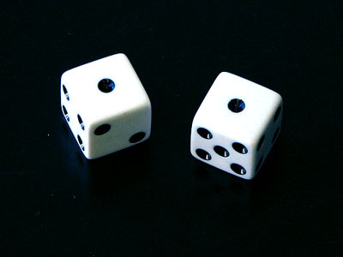
The Sum of Two Dice
QUESTION: What is the sample space for the random process of rolling two dice and taking the sum? Are there 36 possibilities in this sample space? What does the number 36 represent?
What is the probability of rolling "snake eyes"?

Slide 6
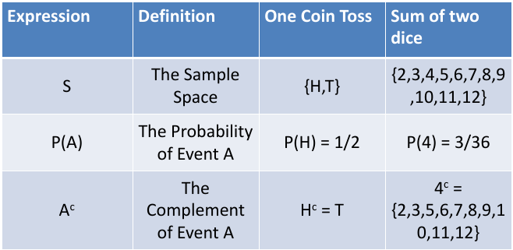
Definitions

Slide 7
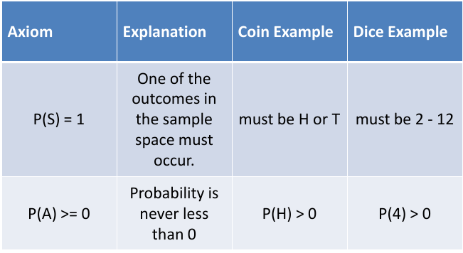
Axioms

Slide 8
Lab work 1. Part 1
1. A spinner has 4 equal sectors colored yellow, blue, green and red. What are the chances of landing on blue after spinning the spinner? What are the chances of landing on red?
2. A single 6-sided die is rolled. What is the probability of each outcome? What is the probability of rolling an even number? of rolling an odd number?
3. A glass jar contains 6 red, 5 green, 8 blue and 3 yellow marbles. If a single marble is chosen at random from the jar, what is the probability of choosing a red marble? a green marble? a blue marble? a yellow marble?

Slide 9
Lab work 1. Part 1
4. Choose a number at random from 1 to 5. What is the probability of each outcome? What is the probability that the number chosen is even? What is the probability that the number chosen is odd?
5. Two 6-sided dies are rolled. What is the probability of rolling a 5+6 combination?
6.26 participants from different countries take part in the championship of badminton. 10 of them are from Kazakhstan including Sultanov. In the first round they were randomly divided into pairs. What is the probability of case that Sultanov played with the sportsman from Kazakhstan?

Slide 10
Lab work 1. Part 1
7. Roll two dice. What is the probability that their sum is three?
8. A pyramidal die has four sides, numbered 1 through 4. The number that is rolled is shown upright. Roll two pyramidal dice. If the sum of the two dice is 2, 3, 7, or 8, Player A gets one point (and player B gets 0). If the sum is 4, 5, or 6, Player B gets one point (and Player A gets 0). Continue rolling the dice. The first person to get ten points is the winner. (1) Is this a fair game? Why or why not? (2) If you think the game is unfair, how could you change it so that it would be fair?

Slide 11
Lab work 1. Part 1
9. Local football association has 10 teams. Team A has 40% chance to score a win in the game against better ranking opponent, and 75% against worse ranking opponent. If team A is currently 4-th on the ranking list, define probability that A will win in the next game.
10. A craftsperson makes stuffed animals for sale. Eighty-five percent of the animals she makes are bears while the remaining 15% are rabbits. Suppose she sells 75% of her bears at craft shows but only 50% of her rabbits are sold at craft shows. What proportion of her animals does she sell at craft shows?
11. A die is rolled and a coin is tossed, find the probability that the die shows an odd number and the coin shows a head.

Slide 12

Conditional Probability
Conditional probability is a way of describing the influence of one event on another.
Example: “Olzhas shoots better from lying position”

Slide 13
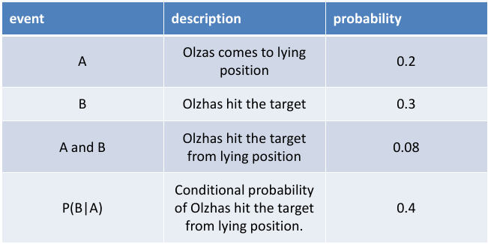
Conditional Probability
P(B|A) = P(A and B)/P(A)

Slide 14
Bayes’ Theorem
1. P(B|A) = P(A and B)/P(A)
Bayes' Theorem is used to solve for the inverse conditional probability, P(A|B). By definition
2. P(A|B) = P(A and B)/P(B)
3. Solving [1] for P(A and B) and substituting into [2] gives
4. Bayes' Theorem:
P(A|B) = [P(B|A)][P(A)] /P(B)

Slide 15
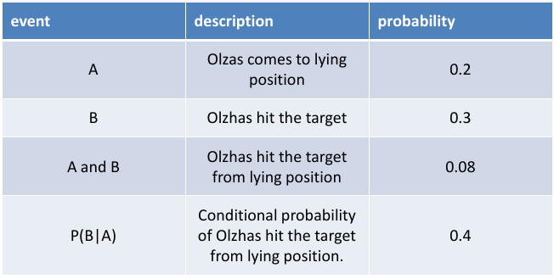
From Example
P(A|B) = [P(B|A)][P(A)]/P(B) = [0.4][0.2]/[0.3] = .267

Slide 16
Lab work 1. Part 2
1. A math teacher gave her class two tests. 25% of the class passed both tests and 42% of the class passed the first test. What percent of those who passed the first test also passed the second test?
2. A jar contains black and white marbles. Two marbles are chosen without replacement. The probability of selecting a black marble and then a white marble is 0.34, and the probability of selecting a black marble on the first draw is 0.47. What is the probability of selecting a white marble on the second draw, given that the first marble drawn was black?
3. The probability that it is Friday and that a student is absent is 0.03. Since there are 5 school days in a week, the probability that it is Friday is 0.2. What is the probability that a student is absent given that today is Friday?

Slide 17
Lab work 1. Part 2
4. Electrical disconnection happens in that case when at least one of the three elements breaks down. Elements are connected sequentially. What is the probability of case the chain will not break? Elements break with probabilities 0,3; 0,4; 0,6 respectively.
5. 6 cards with one letter on each make up the word "spring". Cards are mixed, and then they are pulled out one by one. What is the probability that the cards are pulled out consistently as in the word?
6. Suppose that five good fuses and two defective ones have been mixed up. To find the defective fuses, we test them one-by-one, at random and without replacement. What is the probability that we are lucky and find both of the defective fuses in the first two tests?

Slide 18
Lab work 1. Part 2
7. If six cards are selected at random (without replacement) from a standard deck of 52 cards, what is the probability there will be no pairs? (two cards of the same denomination)
8. Urn 1 contains 5 white balls and 7 black balls. Urn 2 contains 3 whites and 12 black. A fair coin is flipped; if it is Heads, a ball is drawn from Urn 1, and if it is Tails, a ball is drawn from Urn 2. Suppose that this experiment is done and you learn that a white ball was selected. What is the probability that this ball was in fact taken from Urn 2? (i.e., that the coin flip was Tails).

Slide 19
Lab work 1. Part 2
9. Suppose two balls are removed from a bag containing three green and two red balls and that the first ball is not replaced before the second is removed. What is the probability that the balls are the same colour?
10. Two balls are removed from a bag containing three green and two red balls. The first ball is not replaced before the second is removed. If the second ball is red, what is the probability that the first ball was green?
11. What is the probability of picking a spade from a normal pack of cards and rolling an odd number on a die?

